Slide 1
Commercial Communications and Networks
Mobile Commerce and
Wireless Computing Systems

Slide 2
Overview
Communication
  Basic concepts
  The challenge of distance
  Shannon’s reference model
Networks
  Standards
  Media
  Devices and topologies
Notes:
Basic concepts – language, grammar, syntax, messages and meaning.
Distance -

Slide 3
Communication
Essential to commerce
Harder at a distance
Improved by new technology
Determines the structure and behaviour of organisations
Telecommunications and computing convergence
Wireless – real-time, full information availability anywhere and any time.

Slide 4
Basic Concepts
Messages
Transmission
Communicating agents
Language
Symbols and rules
Meaning

Slide 5
Information and Meaning
Domains of discourse
Data – Information - Knowledge – Wisdom
Information as:
  Channel capacity
  Variety
  Reducing uncertainty
  Estimating a parameter

Slide 6
Data & Knowledge
Perspectives
  Inside looking out
  Outside looking at
  Outside looking in
  Outside looking on
Shared meaning

Slide 7
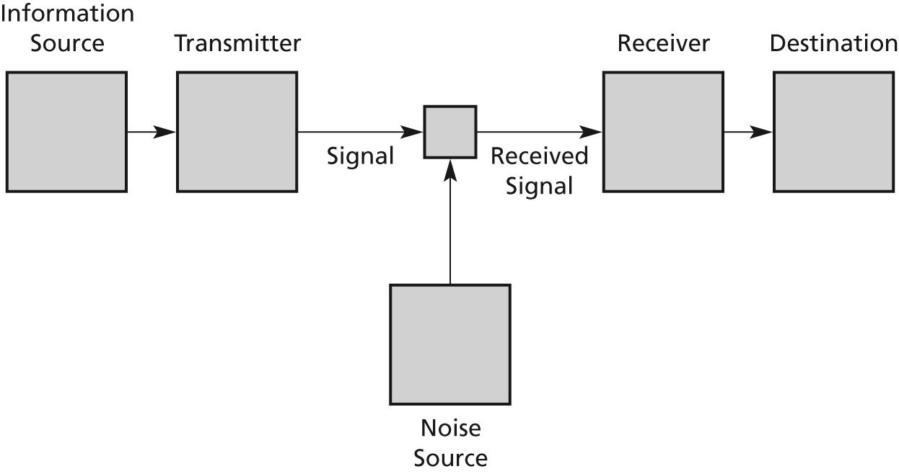
Shannon’s Model
Figure 2.3 A schematic of a general communication system from Shannon (1948)

Slide 8
Information Theory
Source
Transmitter
Channel
Noise
Receiver
Destination

Slide 9
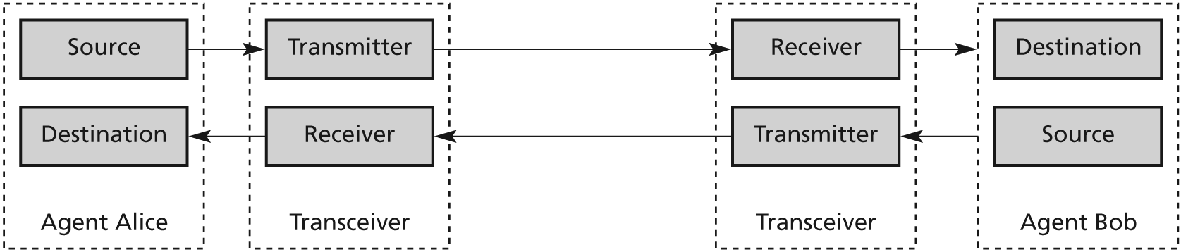
Transceivers
Figure 2.4 Two agent communication via transceivers

Slide 10
Networks
Person-to-person
Computer-to-computer
Media and signals
Infrastructure
Protocols
Devices and topologies

Slide 11
Bound media
Copper wire
Electrical signal
Electromagnetic field
Interference
Coaxial cable, twisted pair
Filters and amplifiers
Fibre optics

Slide 12
Unbound media
Bi-directional/line of sight
  Light
  Infrared
  Microwaves
Radiated/penetrating
Radio waves

Slide 13
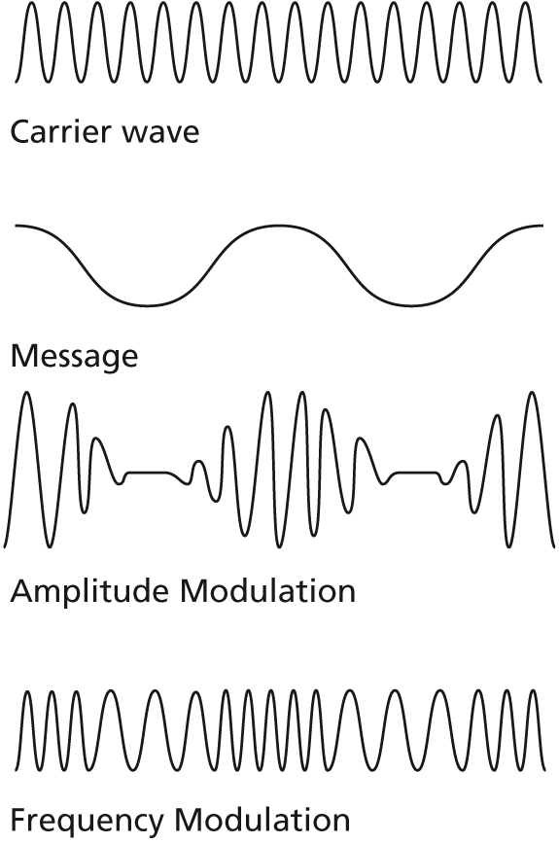
Modulation
    Figure 2.8 Modulation

Slide 14
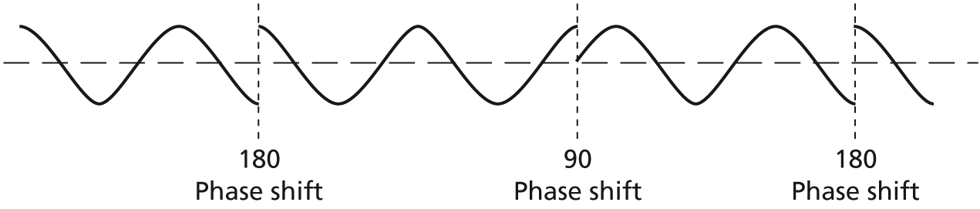
Digitization
Figure 2.9 Waves with different phases
Figure 2.10 Phase modulation

Slide 15
Network Infrastructures
Importance of a message
  Necessity
  Time
  Cost
  Fidelity
One-to-one
One-to-many
One way
Two way
Synchronous
Asynchronous

Slide 16
Channels
Baseband
Broadband
Circuit switching
Packet switching

Slide 17
Protocols
Standards
Agreements
Establishing conventions

